Slide 1


Embedded System and Internet of Things (ESIOT)
UNIT-4
Arduino and Programming
B.E.-CSE 3rd Sem.
Department of Interdisciplinary Courses in Engineering (DICE)
Introduction to Arduino, Architecture of Arduino, Types of Arduino, Arduino Programming Structure , Bare minimum code, Variables, Serial Moitor, Types of Sensors and actuators (temperature, light, motion, motors, relays, displays etc) . Case Studies of Smart home automation, Smart cities, Healthcare and wearable devices

Slide 2
Introduction to Arduino
What is Arduino
A microcontroller board, contains on-board power supply, USB port to communicate with PC, a microcontroller chip.
It simplifies the process of creating any control system by providing the standard board that can be programmed and connected to the system without the need to any sophisticated PCB design and implementation.
Notes:
These processing systems are integrated with components dedicated to handling electric and/or mechanical interfacing.

Slide 3
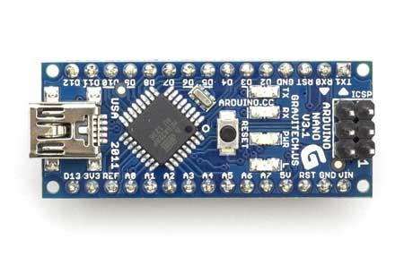
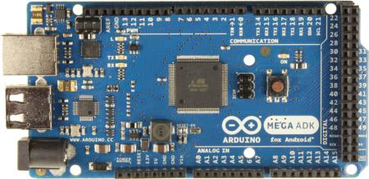
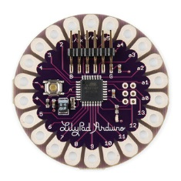
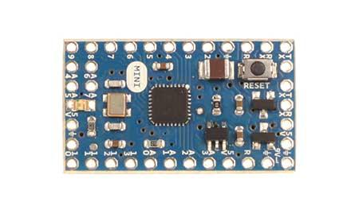
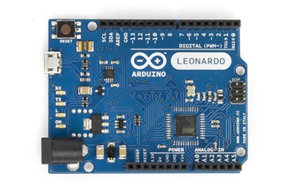
Types of Arduino Boards
_{Arduino Nano}
_{Arduino Mega}
_{Arduino LilyPad}
_{Arduino Uno}
_{Arduino Mini}
_{Arduino Leonardo}

Slide 4
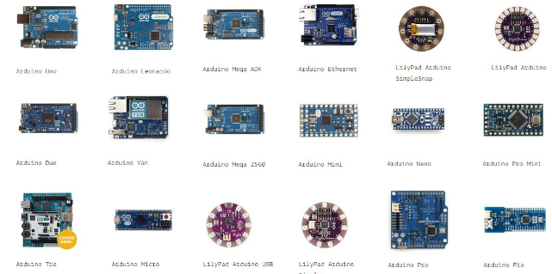
Types of Arduino board
2013: 700.000 official boards were sold.
2016: 17 versions of the Arduino board have been commercially produced.
Notes:
These processing systems are integrated with components dedicated to handling electric and/or mechanical interfacing.

Slide 5
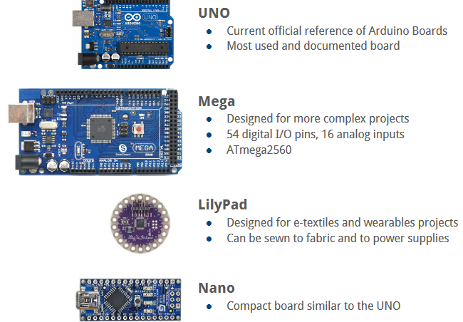
Types of Arduino board
.
Notes:
These processing systems are integrated with components dedicated to handling electric and/or mechanical interfacing.

Slide 6
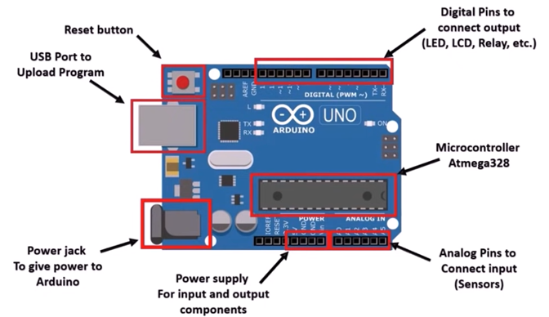
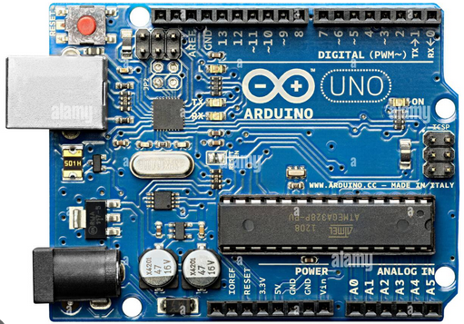

Arduino UNO
.
Digital pins:
14 digital IO pins
6 are PWM pins (3, 5, 6, 9, 10, and 11).
Analog pins:
6 analog pins(A0, A1, A2, A3, A4, and A5)
Takes analog values as an input

Slide 7
Board Breakdown
Here are the components that make up an Arduino board and what each of their functions are.
1. Reset Button – This will restart any code that is loaded to the Arduino board
2. AREF – Stands for “Analog Reference” and is used to set an external reference voltage
3. Ground Pin – There are a few ground pins on the Arduino and they all work the same
4. Digital Input/Output – Pins 0-13 can be used for digital input or output
5. PWM – The pins marked with the (~) symbol can simulate analog output
6. USB Connection – Used for powering up your Arduino and uploading sketches
Notes:
These processing systems are integrated with components dedicated to handling electric and/or mechanical interfacing.

Slide 8
Board Breakdown
7. TX/RX – Transmit and receive data indication LEDs
8. ATmega Microcontroller – This is the brains and is where the programs are stored
9. Power LED Indicator – This LED lights up anytime the board is plugged in a power source
10. Voltage Regulator – This controls the amount of voltage going into the Arduino board
11. DC Power Barrel Jack – This is used for powering your Arduino with a power supply
12. 3.3V Pin – This pin supplies 3.3 volts of power to your projects
13. 5V Pin – This pin supplies 5 volts of power to your projects
14. Ground Pins – There are a few ground pins on the Arduino and they all work the same
15. Analog Pins – These pins can read the signal from an analog sensor and convert it to digital
Notes:
These processing systems are integrated with components dedicated to handling electric and/or mechanical interfacing.

Slide 9
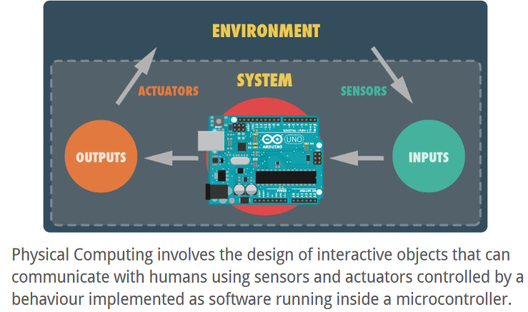
Arduino as Physical Computing Platform
.
Notes:
These processing systems are integrated with components dedicated to handling electric and/or mechanical interfacing.

Slide 10
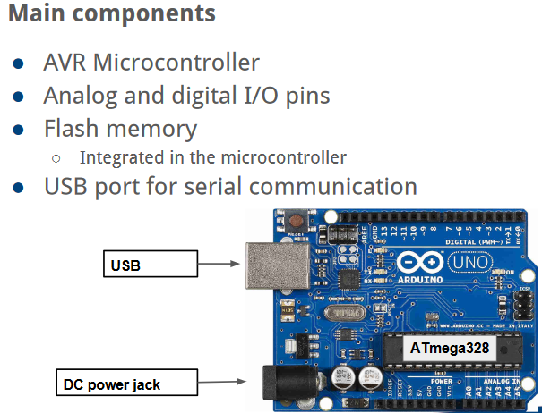
General Architecture
.
Notes:
These processing systems are integrated with components dedicated to handling electric and/or mechanical interfacing.

Slide 11
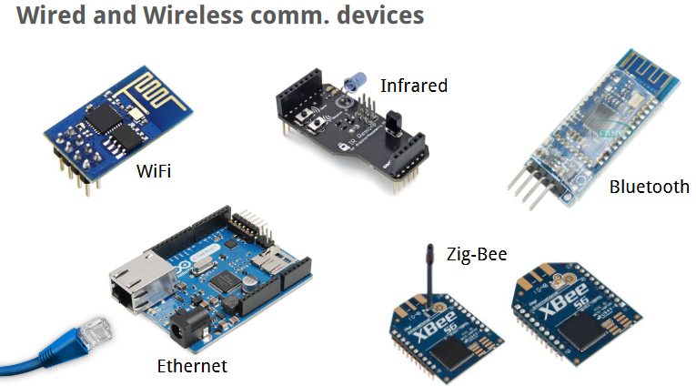
Arduino Communication Devices
.
Notes:
These processing systems are integrated with components dedicated to handling electric and/or mechanical interfacing.

Slide 12
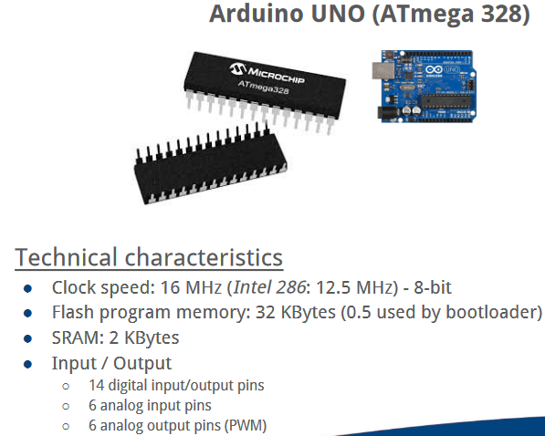
Characteristics
.
Notes:
These processing systems are integrated with components dedicated to handling electric and/or mechanical interfacing.

Slide 13
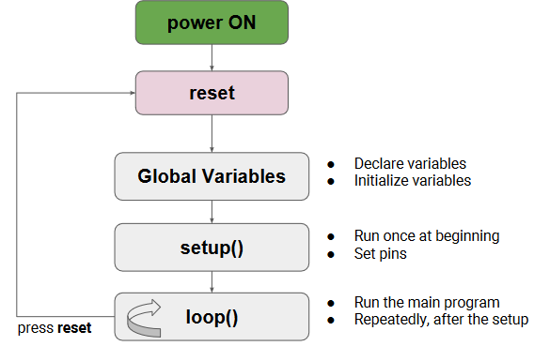
Programming in Arduino
.
Notes:
These processing systems are integrated with components dedicated to handling electric and/or mechanical interfacing.

Slide 14
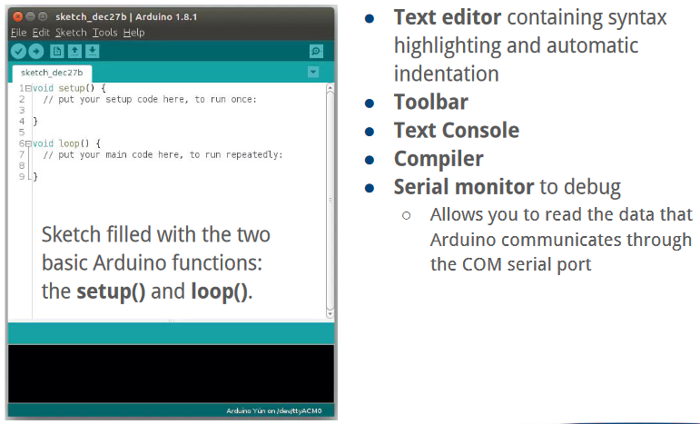
Arduino IDE Software
.
Notes:
These processing systems are integrated with components dedicated to handling electric and/or mechanical interfacing.

Slide 15
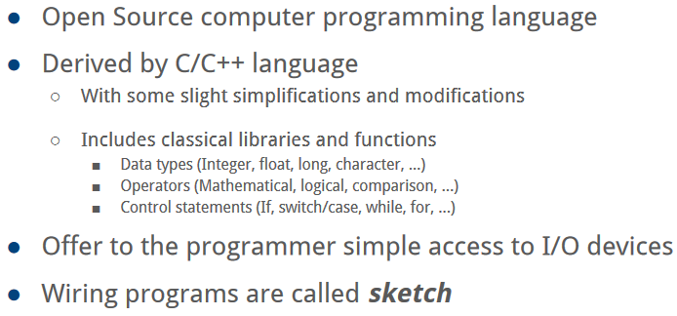
Writing Based Language
.
Notes:
These processing systems are integrated with components dedicated to handling electric and/or mechanical interfacing.

Slide 16
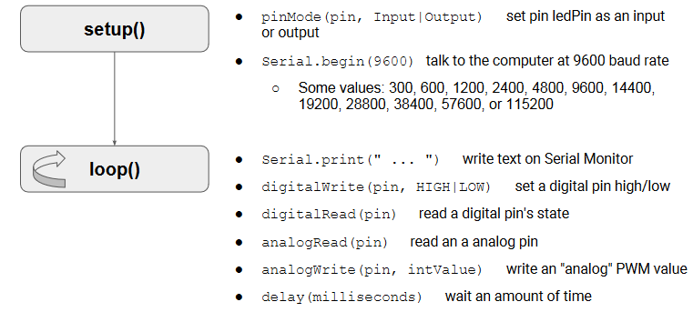
Some Functions
.
Notes:
These processing systems are integrated with components dedicated to handling electric and/or mechanical interfacing.

Slide 17
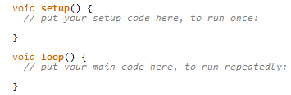
Bare Minimum Code
The bare minimum of code needed to start an Arduino sketch.
Notes:
These processing systems are integrated with components dedicated to handling electric and/or mechanical interfacing.

Slide 18
Bare Minimum Code
The setup() function is called when a sketch starts. Use it to initialize variables, pin modes, start using libraries, etc. The setup function will only run once, after each powerup or reset of the Arduino board.
After creating a setup() function, the loop() function does precisely what its name suggests, and loops consecutively, allowing your program to change and respond as it runs. Code in the loop() section of your sketch is used to actively control the Arduino board.
Notes:
These processing systems are integrated with components dedicated to handling electric and/or mechanical interfacing.

Slide 19
Variables
Variables are essential for storing data that your programs can manipulate.
Key types:
1. Integers:
- int: Stores whole numbers (e.g., -32,768 to 32,767).
- long: For larger integers (e.g., -2,147,483,648 to 2,147,483,647).
- short: A smaller integer type (e.g., -32,768 to 32,767).
- byte: Stores an 8-bit unsigned integer (0 to 255).
2. Floating-Point
- float: For decimal numbers with single precision (approximately 6-7 decimal places).
double: For decimal numbers with double precision (approximately 15 decimal places), but on some Arduino boards, it may be the same as `float`.
3. Character:
- char : Stores a single character (e.g., 'A', '1', or '#'). It uses 1 byte of memory.
Notes:
These processing systems are integrated with components dedicated to handling electric and/or mechanical interfacing.

Slide 20
Variables
4. Boolean:
- bool: Represents a truth value, either `true` or `false`.
5. String
- String: A class that allows manipulation of text strings. It dynamically allocates memory.
6. Arrays
- Arrays allow you to store multiple values of the same type in a single variable.
- Example: `int numbers[5];` creates an array of five integers.
7. User-Defined Types
- You can define your own data types using `struct` or `class` for more complex data structures.
Notes:
These processing systems are integrated with components dedicated to handling electric and/or mechanical interfacing.

Slide 21
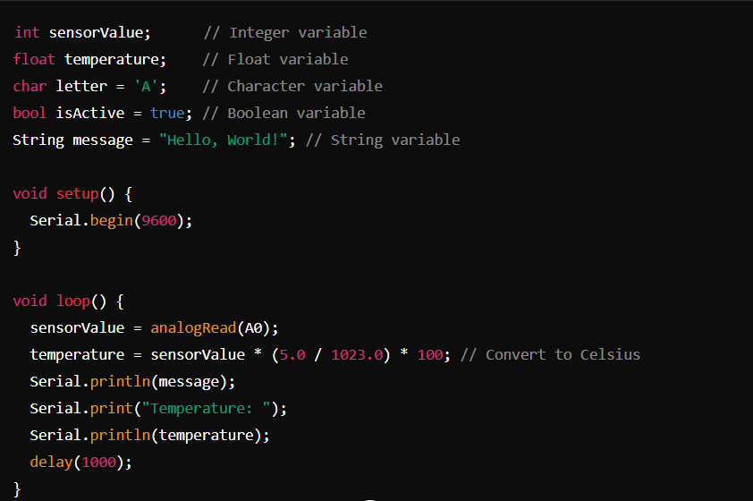
Variables Examples
Notes:
These processing systems are integrated with components dedicated to handling electric and/or mechanical interfacing.

Slide 22
Serial Monitor
The Serial Monitor in Arduino is a tool that allows you to communicate with your Arduino board from your computer. It is useful for debugging, monitoring data, and sending commands to your Arduino.
In the Arduino IDE, Serial Monitor displays data sent from the Arduino board to your computer via the serial port. We can also send data from your computer to the Arduino.
The basic function includes setting the Baud Rate. Common rates include 9600, 115200, etc.
Sending Data: You can type text into the input field at the top of the Serial Monitor and send it to the Arduino by clicking the “Send” button or pressing Enter.
Notes:
These processing systems are integrated with components dedicated to handling electric and/or mechanical interfacing.

Slide 23
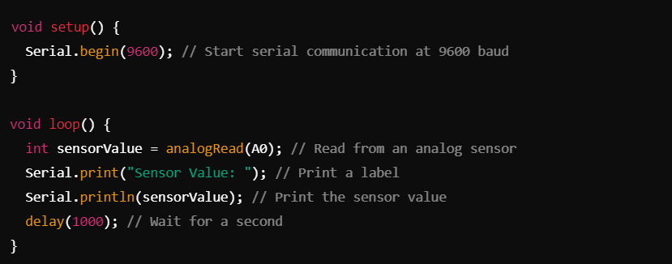
Common Serial commands
Serial.begin(baudRate): Initializes serial communication at the specified baud rate.
Serial.print(data): Sends data to the Serial Monitor without a newline.
Serial.println(data): Sends data followed by a newline character.
Serial.read(): Reads incoming data from the serial buffer.
Serial.available(): Checks how many bytes are available to read from the serial buffer.
Notes:
These processing systems are integrated with components dedicated to handling electric and/or mechanical interfacing.

Slide 24
Types of Sensors
Arduino supports various sensors that allow you to gather data from the environment and interact with physical systems. Here are some common types of sensors used with Arduino:
1) Temperature Sensors:
DHT11/DHT22: Measures temperature and humidity. Commonly used in weather stations.
LM35: Analog temperature sensor that provides a voltage output proportional to the temperature.
2) Light Sensors:
Photoresistor (LDR): Changes resistance based on light levels. Used in projects like automatic lighting.
TSL2561: Digital light sensor that provides precise readings of light intensity.
3) Distance Sensors:
Ultrasonic Sensor (HC-SR04): Measures distance using ultrasonic waves. Useful in obstacle detection and range finding.
Infrared (IR) Sensors: Measure distance using infrared light. Common in robotics.
Notes:
These processing systems are integrated with components dedicated to handling electric and/or mechanical interfacing.

Slide 25
Types of Sensors
4) Motion Sensors:
PIR Sensor: Detects motion based on changes in infrared radiation. Used in security systems.
Accelerometer (e.g., ADXL345): Measures acceleration and tilt, useful in mobile applications and robotics.
5) Pressure Sensors:
BMP180/BMP280: Measures atmospheric pressure and temperature. Useful in altitude detection and weather applications.
6) Gas Sensors:
MQ Series (e.g., MQ-2, MQ-7): Detects various gases (smoke, CO, etc.). Useful in air quality monitoring.
CCS811: Measures CO2 and total volatile organic compounds (TVOCs).
7) Humidity Sensors:
DHT11/DHT22: Besides temperature, they also measure humidity.
8) Soil Moisture Sensors:
Measures the moisture level in soil, commonly used in automated irrigation systems.
Notes:
These processing systems are integrated with components dedicated to handling electric and/or mechanical interfacing.

Slide 26
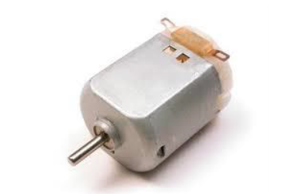
Motors
There are three different type of motors −
DC motor
Servo motor
Stepper motor
1) A DC motor (Direct Current motor) is the most common type of motor. DC motors normally have just two leads, one positive and one negative. If you connect these two leads directly to a battery, the motor will rotate. If you switch the leads, the motor will rotate in the opposite direction.
Notes:
These processing systems are integrated with components dedicated to handling electric and/or mechanical interfacing.

Slide 27
Motors
Speed direction control:
To control the direction of the spin of DC motor, without interchanging the leads, you can use a circuit called an H-Bridge. An H-bridge is an electronic circuit that can drive the motor in both directions. H-bridges are used in many different applications. One of the most common application is to control motors in robots. It is called an H-bridge because it uses four transistors connected in such a way that the schematic diagram looks like an "H.“ Ex: L298 H-Bridge IC. The L298 can control the speed and direction of DC motors and stepper motors, and can control two motors simultaneously. Its current rating is 2A for each motor. At these currents, however, you will need to use heat sinks.
Notes:
These processing systems are integrated with components dedicated to handling electric and/or mechanical interfacing.

Slide 28
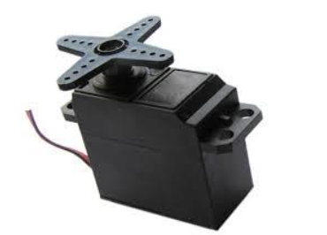
Motors
2) A Servo Motor is a small device that has an output shaft. This shaft can be positioned to specific angular positions by sending the servo a coded signal. As long as the coded signal exists on the input line, the servo will maintain the angular position of the shaft. If the coded signal changes, the angular position of the shaft changes. In practice, servos are used in radio-controlled airplanes to position control surfaces like the elevators and rudders. They are also used in radio-controlled cars, puppets, and robots.
Notes:
These processing systems are integrated with components dedicated to handling electric and/or mechanical interfacing.

Slide 29
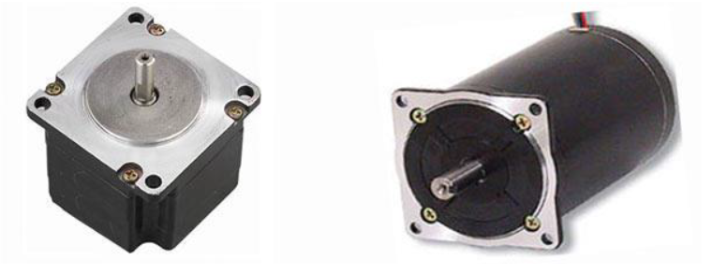
Motors
3) A Stepper Motor or a step motor is a brushless, synchronous motor, which divides a full rotation into a number of steps. Unlike a brushless DC motor, which rotates continuously when a fixed DC voltage is applied to it, a step motor rotates in discrete step angles.
The Stepper Motors therefore are manufactured with steps per revolution of 12, 24, 72, 144, 180, and 200, resulting in stepping angles of 30, 15, 5, 2.5, 2, and 1.8 degrees per step. The stepper motor can be controlled with or without feedback.
Notes:
These processing systems are integrated with components dedicated to handling electric and/or mechanical interfacing.

Slide 30
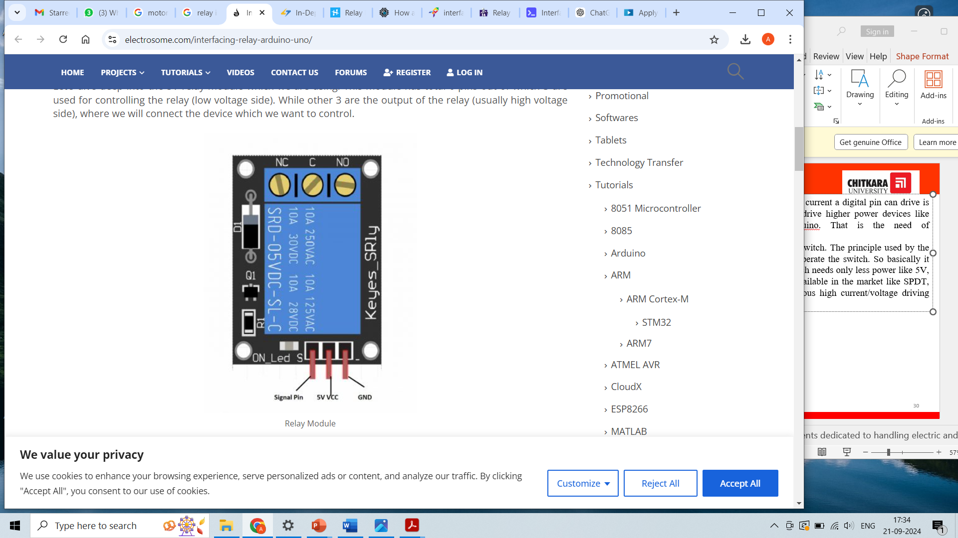
Relays
Arduino Uno work on 5V and the maximum current a digital pin can drive is less than 40mA. So technically we cannot drive higher power devices like home appliances directly with arduino. That is the need of electromechanical RELAY.
A relay is generally an electrically operated switch. The principle used by the relays is an electromagnet to mechanically operate the switch. So basically it operates a switch using an electromagnet which needs only less power like 5V, 12V or 24V. Different kinds of relays are available in the market like SPDT, DPDT, SPST, 5V, 12V, 24V and with various high current/voltage driving capacity.
Notes:
These processing systems are integrated with components dedicated to handling electric and/or mechanical interfacing.

Slide 31
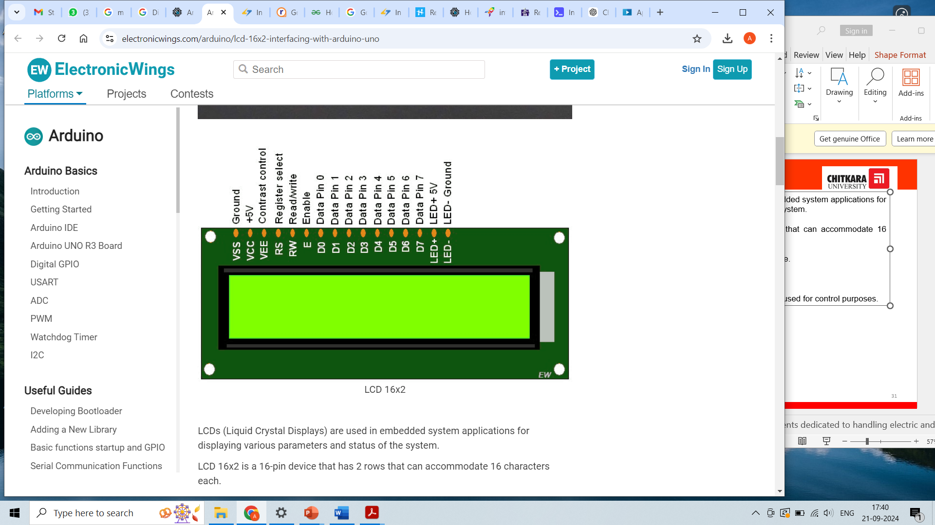
Displays
LCDs (Liquid Crystal Displays) are used in embedded system applications for displaying various parameters and status of the system.
LCD 16x2 is a 16-pin device that has 2 rows that can accommodate 16 characters each.
LCD 16x2 can be used in 4-bit mode or 8-bit mode.
It is also possible to create custom characters.
It has 8 data lines and 3 control lines that can be used for control purposes.
Notes:
These processing systems are integrated with components dedicated to handling electric and/or mechanical interfacing.

Slide 32
Arduino Case Studies

Slide 33
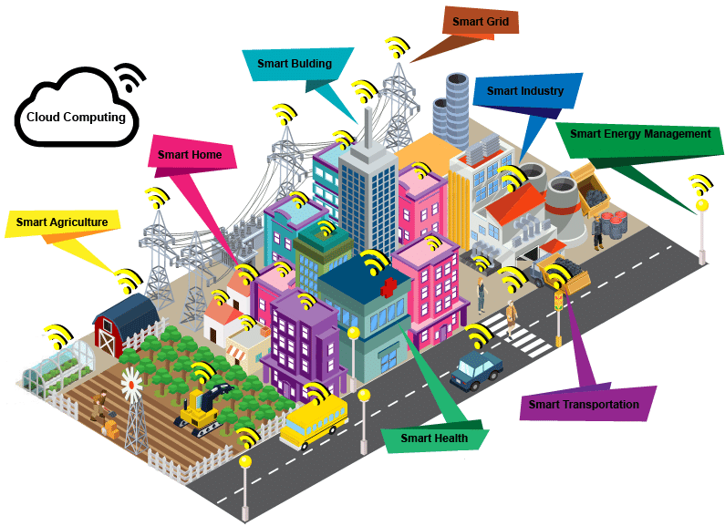
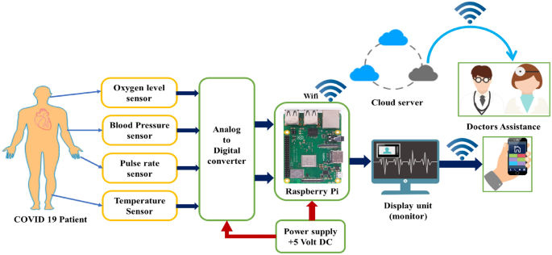
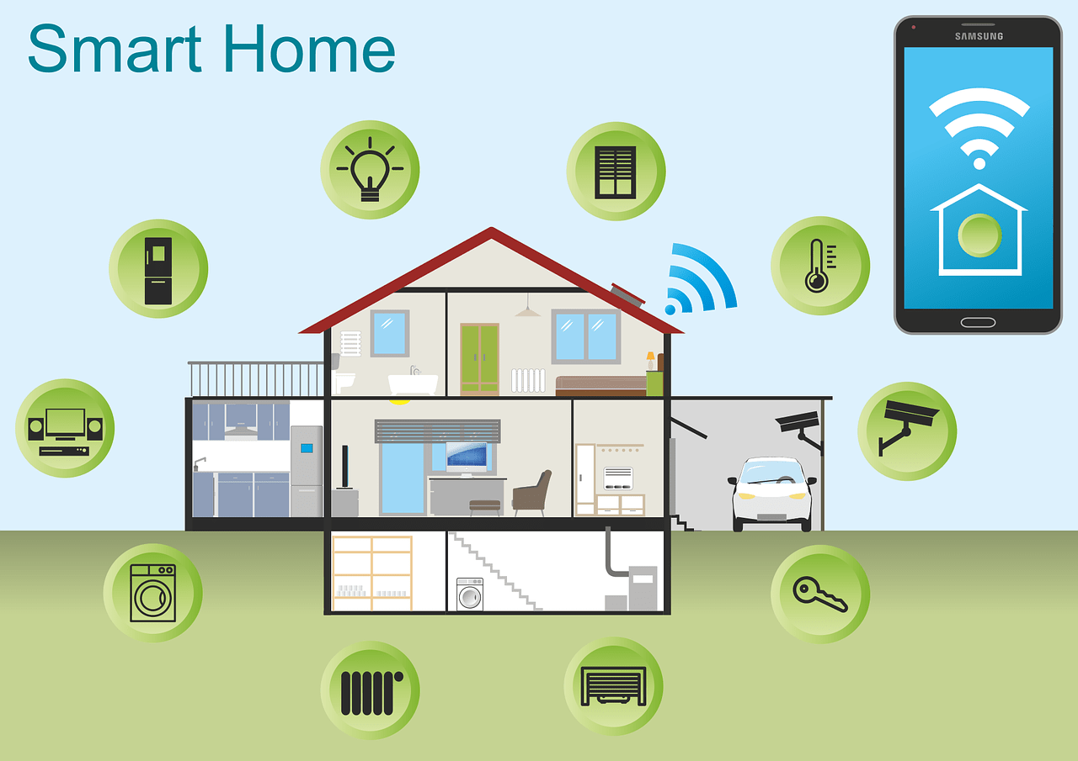

Case Studies and Applications
Example 1: Smart Cities
Smart Traffic Management System
Smart Waste Management System
Example 2: Healthcare
Heart rate monitoring system
Glucose Monitoring system
Example 3: Smart Home Automation
Smart Lighting System
Security system
Example 4: Wearable Devices
Posture Monitoring Device
Smart Fitness Tracker

Slide 34
Smart Home Automation Overview
What is Smart Home Automation?
Smart home automation involves using technology to control home appliances, lighting, heating, and security remotely or automatically.
Common examples include controlling lights with a smartphone app, using voice assistants like Alexa to manage home devices, and using sensors to adjust home conditions based on occupancy or temperature.
Why Arduino?
Arduino provides an accessible, low-cost platform for building custom smart home systems.
Unlike expensive, proprietary smart home systems, Arduino projects can be tailored to individual needs and connected to a wide variety of components and devices.
With its ability to connect to the internet (via Wi-Fi modules) and interact with sensors, Arduino makes it easy to build smart home projects from scratch.

Slide 35
Arduino in Smart Home Automation
Project Example: Smart Lighting System
Arduino Components Used: Arduino Uno (the main microcontroller board), motion sensors (to detect movement), relays (to switch high-voltage devices like light bulbs), and the light bulbs themselves.
Functionality: The motion sensors detect when someone enters or leaves a room, automatically turning the lights on or off accordingly. This system can be extended to dim lights, change colors, or set timers.
Benefits: This saves energy by ensuring lights are only on when needed, and it's also a cost-effective solution compared to commercial smart lighting systems.
Project Example: Security System
Components: Motion sensor to detect intruders, camera module to capture images or video, buzzer for alerts, and a Wi-Fi module for sending notifications.
Functionality: When the motion sensor detects movement, the Arduino triggers the buzzer and captures images via the camera module. An alert is then sent to the homeowner’s phone.
Impact: Such a system improves home security and is relatively inexpensive compared to professional home security systems.

Slide 36
Smart Cities Overview
What are Smart Cities?
Smart cities integrate advanced technologies (IoT, sensors, data analysis) into infrastructure to improve quality of life.
Examples include efficient public transportation, smart grids, environmental monitoring, and waste management systems.
The goal of a smart city is to make urban living more sustainable, efficient, and responsive to the needs of its inhabitants.

Slide 37
Arduino in Smart Cities
Project Example: Smart Traffic Management
Arduino Components: Ultrasonic sensors (to measure the number of vehicles), RF modules (for wireless communication between traffic lights), and LEDs (to signal traffic).
Functionality: Ultrasonic sensors detect traffic volume at intersections. The Arduino adjusts traffic light timings dynamically based on the data, allowing for more efficient flow of vehicles during peak hours.
Impact: This reduces traffic congestion and travel time, leading to a smoother flow of traffic, reduced pollution, and fewer accidents.
Project Example: Smart Waste Management
Components: Ultrasonic sensors (to measure waste levels in bins), Arduino Mega (to process data), GSM module (to send alerts to waste management services).
Functionality: The sensors track the level of waste in public bins, and when full, an alert is sent to city waste services, ensuring timely emptying of bins.
Impact: This minimizes the overflow of trash, reduces the need for constant monitoring by city personnel, and leads to a cleaner city environment.

Slide 38
Healthcare Overview
How is Arduino Revolutionizing Healthcare?
Arduino enables rapid development of low-cost medical devices that can help in monitoring and managing health conditions.
For communities or countries with limited access to expensive healthcare equipment, Arduino-based devices can be a more affordable alternative.
It also encourages DIY medical innovation, with tools that allow individuals to monitor their own health or create custom health solutions.

Slide 39
Arduino in Healthcare
Project Example: Heart Rate Monitoring System
Arduino Components: Pulse sensor (to measure heartbeats), OLED display (to show data), Bluetooth module (to send data to a smartphone).
Functionality: The pulse sensor monitors the user’s heart rate, displaying real-time data on the OLED screen. The Bluetooth module allows for wireless transmission of the data to a smartphone or computer for further analysis.
Impact: This device is portable and affordable compared to commercial heart rate monitors, making it accessible for home use or in remote areas.
Project Example: Glucose Monitoring Device
Components: Arduino Nano (a small and compact board), glucose sensor (to measure blood sugar levels), and a buzzer (for alerts).
Functionality: The sensor monitors blood glucose levels and sends an alert when readings are outside the normal range. The device can log the data for future reference or transmit it to a doctor.
Impact: This low-cost device can help diabetic patients monitor their condition at home, reducing the need for constant doctor visits and improving self-care.

Slide 40
Arduino in Wearable Devices
Project Example: Smart Fitness Tracker
Arduino Components: Arduino Pro Mini (small and low-power), accelerometer (to measure movement), pulse sensor (to measure heart rate).
Functionality: The fitness tracker monitors daily activity like steps taken and heart rate. It provides feedback to the user via a smartphone or a small display.
Impact: This makes fitness tracking more affordable and customizable. Unlike commercial fitness trackers, you can build and tweak the system based on personal preferences.
Project Example: Posture Monitoring Device
Components: Gyroscope sensor (to measure body orientation), Arduino Nano (small and compact), vibration motor (for feedback).
Functionality: The gyroscope sensor tracks the user’s posture. If it detects slouching or poor posture, the vibration motor activates, gently reminding the user to adjust their posture.
Impact: This wearable device helps users develop better posture habits, reducing the risk of back pain or long-term posture issues, and is a low-cost alternative to commercial posture correction devices.

Slide 41
Conclusion
Key Takeaways:
Arduino is a versatile and powerful tool, driving innovation across multiple industries.
In smart homes, it enables low-cost, energy-efficient automation solutions.
For smart cities, Arduino improves resource management and urban efficiency.
In healthcare, it offers affordable, customizable devices for health monitoring.
The wearable industry benefits from Arduino’s compactness and ease of prototyping, allowing anyone to create fitness, health, and lifestyle trackers.
The Future of Arduino: With continued advancements, Arduino's role in these fields will only grow, offering more sophisticated and integrated solutions.

